Slide 1
Lecture 10-1 AXI Video DMA and VGA Driver
Assignment
References
Zybo Base system Design Introduction
AXI Interface Review
General purpose, high performance, ACP
Direct Memory Access (DMA)
Memory-mapped vs. Streaming
AXI Video Direct Memory Access
VGA Review
VGA/HDMI Display Controller axi_dispctrl_v1-00_a

Slide 2
Assignment
Lab #9 VGA, Image Creation and Boot Loader on Zybo
Due by Saturday, August 21,2021

Slide 3
References
Vivado Design Suite, AXI Reference Guide UG1037 (v3.0) June 24, 2015, Xilinx
AXI Video Direct Memory Access v6.2, LogiCORE IP Product Guide, Vivado Design Suite, PG020, November 18, 2015, Xilinx
AXI DMA v7.1 LogiCORE IP Product Guide, Vivado Design Suite, PG021, November 18, 2015, Xilinx
AXI4-Stream Video IP and System Design Guide, UG934 (v2.2) April 6, 2016, Xilinx
Getting Started with AXI4-Stream Interface in Zynq Workflow, Mathworks, http://www.mathworks.com/help/hdlcoder/examples/getting-started-with-axi4-stream-interface-in-zynq-workflow.html?s_tid=gn_loc_drop.
axi stream interface by Mohammadsadegh Sadri, http://www.googoolia.com/wp/2014/04/12/lesson-3-axi-stream-interface/.
Zybo Base System Design, Digilient, https://reference.digilentinc.com/zybo:zybo
Download ZYBO_master project folder

Slide 4
Zybo Base System Design (https://reference.digilentinc.com/zybo:zybo)
Zynq, ARM
axi_vdma_0, AXI Video Direct Memory Access, Xilinx
axi_dispctrl_0, AXI VGA and HDMI Display Controller, Digilent
Hdmi_tx_0, HDMI Transmitter
axi_i2s_adi_1, AXI Auio Codec Controller for Analog Devices SSM2603 Audio Codec
AXI General Purpose Port, Synchronization Message Interface
AXI high Performance Port, Memory Interface
Zybo Base System Design, Digilient

Slide 5
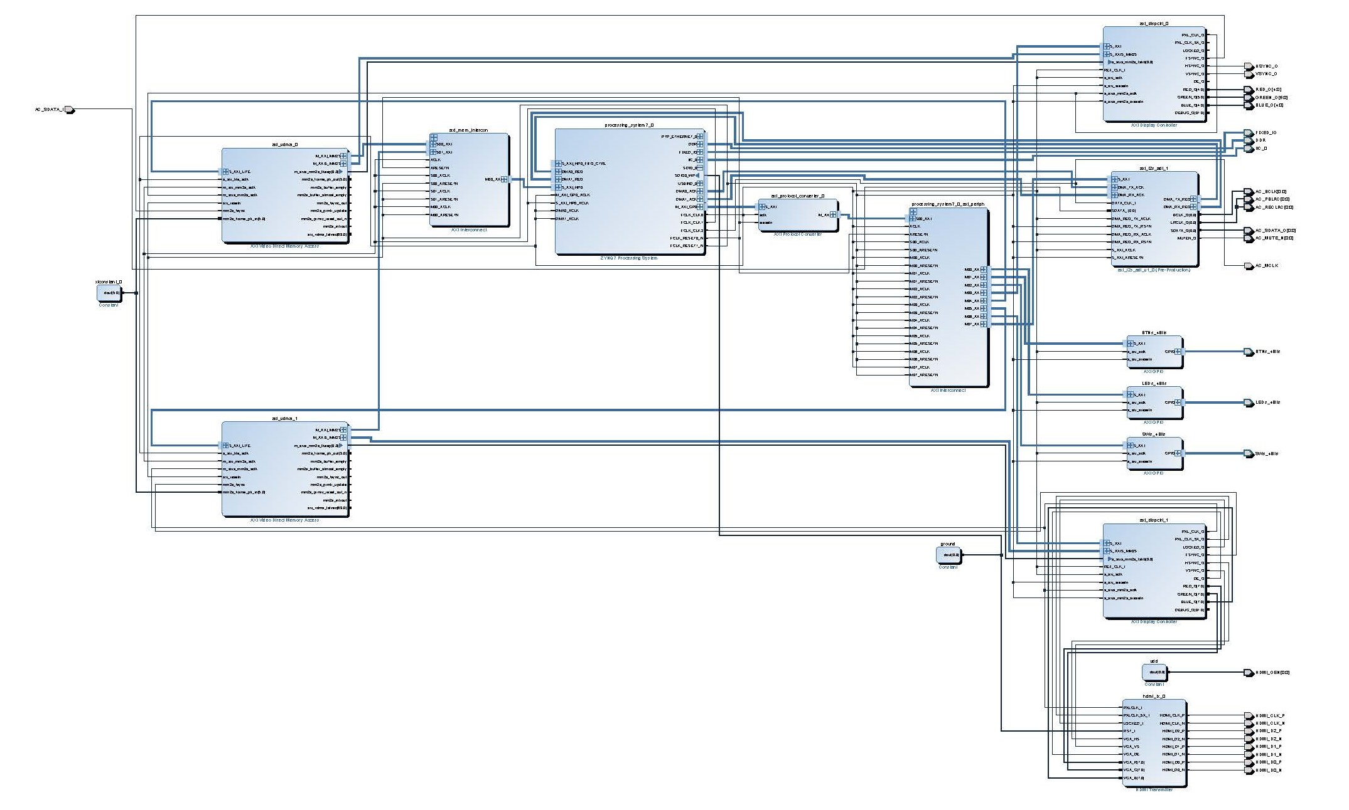
Zybo Base System Design (https://reference.digilentinc.com/zybo:zybo)
Zybo Base System Design, Digilient

Slide 6
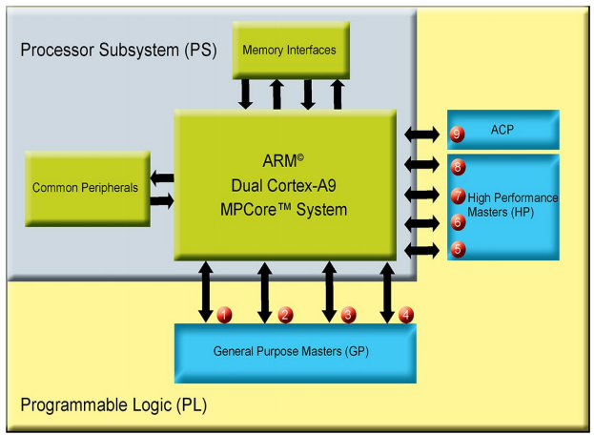
AXI Interfaces between PS and PL
General-Purpose Port
High Performance Port
Accelerator Coherency Port (ACP)
White_Paper_Data-Transfer-in-ZYNQ_Sept_2014

Slide 7
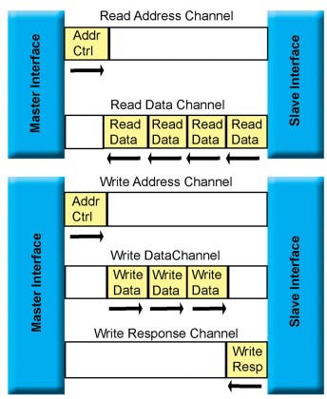
AXI Interface and Protocol
1) Read Address Channel
2) Read Data Channel
3) Write Address Channel
4) Write Data Channel
5) Write Response Channel
Master always initiates communications
Provides address
Write
Read
White_Paper_Data-Transfer-in-ZYNQ_Sept_2014

Slide 8
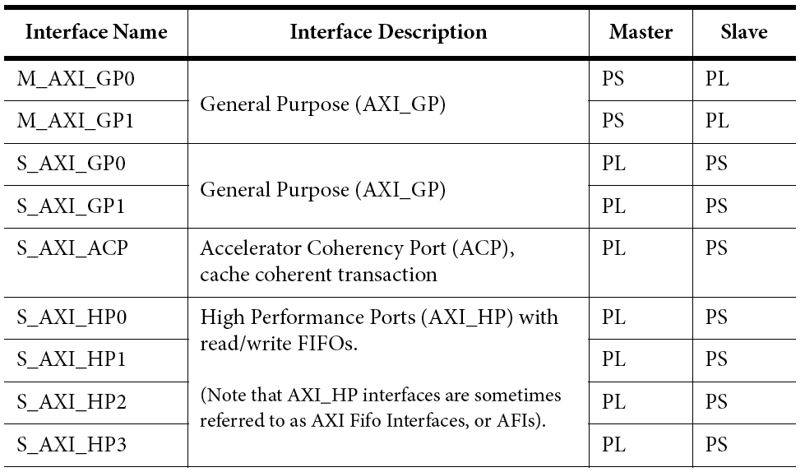
AXI Interfaces between PS and PL on Zynq
Two general purpose ports; one ACP port, four high performance ports
Source: the Zynq Book

Slide 9
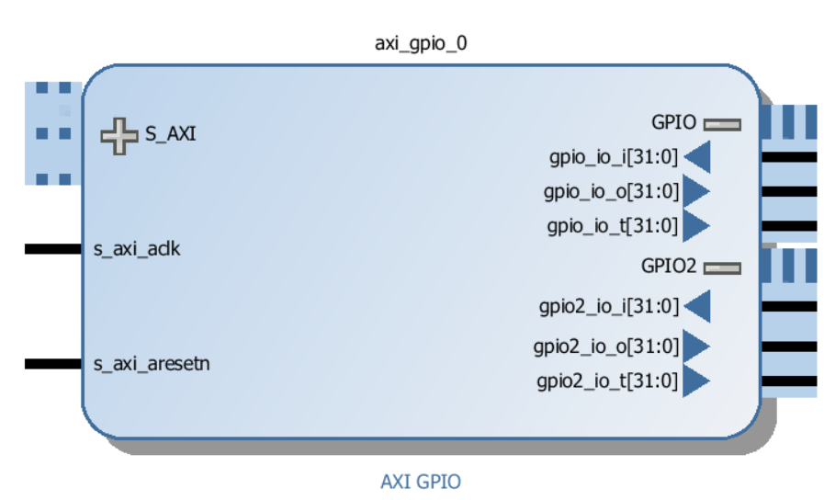
General-Purpose Port Summary
GP ports are designed for maximum flexibility
Input, output or tristate output
Allow register access from PS to PL or PL to PS
Good for Synchronization
Prefer ACP or HP port for data transport

Slide 10
High-Performance Port Summary
HP ports are designed for maximum bandwidth access to external memory and On-Chip Memory (OCM)
When combined can saturate external memory and OCM bandwidth
HP Ports : 4 * 64 bits * 150 MHz * 2 = 9.6 GByte/sec
external DDR: 1 * 32 bits * 1066 MHz * 2 = 4.3 GByte/sec
OCM : 64 bits * 222 MHz * 2 = 3.5 GByte/sec
Optimized for large burst lengths and many outstanding transactions
Large data buffers to amortize access latency
Efficient upsizing/downsizing for 32 bit accesses

Slide 11
Accelerator Coherency Port (ACP) Summary
ACP allows limited support for Hardware Coherency
– Allows a PL accelerator to access cache of the Cortex-A9 processors
– PL has access through the same path as CPUs including caches, OCM, DDR, and peripherals
– Access is low latency (assuming data is in processor cache) no switches in path
ACP does not allow full coherency
– PL is not notified of changes in processor caches
– Use write to PL register for synchronization
ACP is compromise between bandwidth and latency
– Optimized for cache line length transfers
– Low latency for L1/L2 hits
– Minimal buffering to hide external memory latency
– One shared 64 bit interface, limit of 8 masters

Slide 12
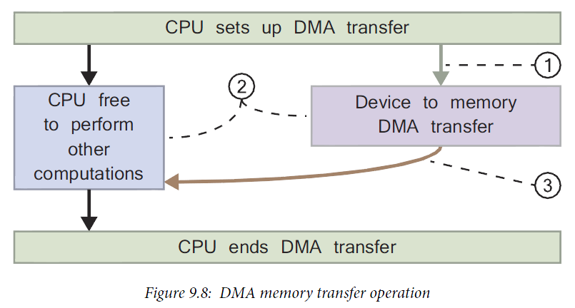
Direct Memory Access: without CPU Involvement in Data Transfer
1. The processor sets up the device wishing to use the DMA to transfer data to memory by issuing a DMA command and disables all DMA interrupts.
2. The DMA controller transfers data from the peripheral device to memory leaving the CPU free to perform other computations.
3. Following completion of the data transfer, an interrupt is sent to the CPU to inform it that it can close the DMA transfer.
The Zynq Book

Slide 13
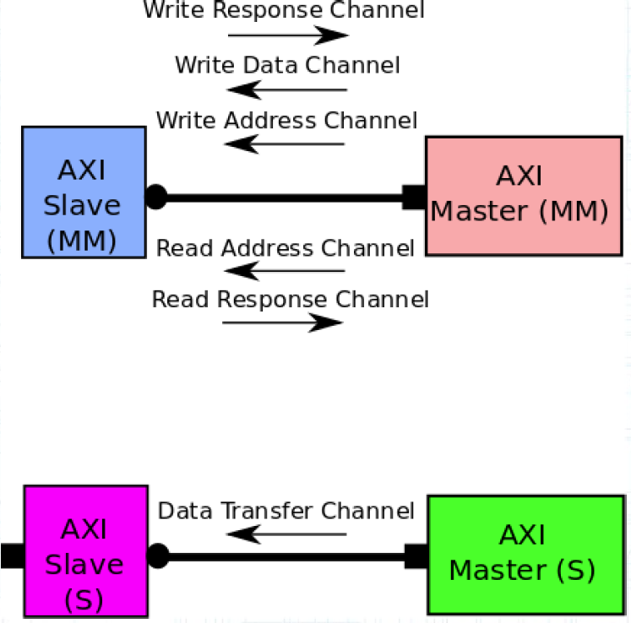
AXI Memory-Mapped vs. AXI Stream
Memory Mapped data transfer
Read/Write transactions contain destination address
an address is specified within the transaction issued by the master (read or write), which corresponds to an address in the system memory space
Streaming data transfer
No individual address is needed
A single channel is defined for the transmission of streaming data
One AXI channel, One way!
Source: M.S. Sadri, Zynq Training

Slide 14
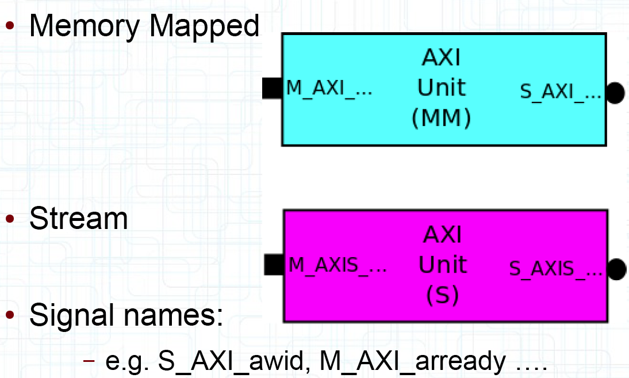
AXI Port Naming Conventions: axi vs. axis
axi – memory mapped interface
axis – streaming interface
Source: M.S. Sadri, Zynq Training

Slide 15
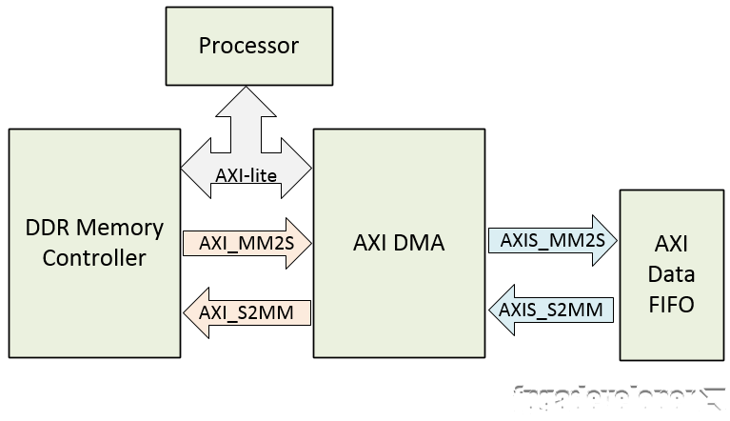

AXI DMA (from FPGA Developer) – AXI-lite, AXI Streaming
The processor and DDR memory controller are contained within the Zynq PS.
The AXI DMA and AXI Data FIFO are implemented in the Zynq PL.
The AXI-lite bus allows the processor to communicate with the AXI DMA to setup, initiate and monitor data transfers.
I/O side is called streaming
Memory side is called Memory Mapped
http://www.fpgadeveloper.com/2014/08/using-the-axi-dma-in-vivado.html

Slide 16
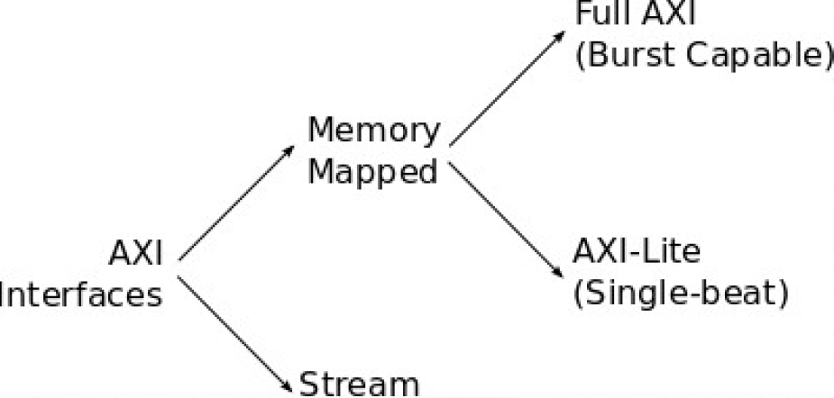
AXI DMA (from FPGA Developer)
AXI_MM2S and AXI_S2MM are memory-mapped AXI4 buses and provide the DMA access to the DDR memory.
The AXIS_MM2S and AXIS_S2MM are AXI4-streaming buses, which source and sink a continuous stream of data, without addresses.
MM2S stands for Memory-Mapped to Streaming PL
S2MM stands for PL Streaming to Memory-Mapped
(High-Performance)
(Shared Bus)
(Peripheral)
(Point-to-Point Bus)
Source: M.S. Sadri, Zynq Training

Slide 17
Types of DMA with Zynq
AXI CDMA – AXI Central Direct Memory Access
Provides high bandwidth direct memory access between the DDR memory and AXI-Stream type target peripherals. Most useful when the data is transferred from DDR memory to a Block Ram memory on PL.
AXI Data mover
Enables high throughput transfer of data between AXI4 memory mapped domain to AXI4-Stream domain. Provides MM2S and S2MM AXI4-Stream channel which operates independently in a full duplex like method.
AXI DMA – AXI Direct Memory Access
Provides high-bandwidth direct memory access between memory and AXI4-Stream-type target peripherals. Optional scatter gather capabilities.
AXI VDMA – AXI Video Direct Memory Access
The AXI Video Direct Memory Access (AXI VDMA) core is a soft Xilinx IP core that provides high-bandwidth direct memory access between memory and AXI4-Stream type video target peripherals. Provides efficient two dimensional DMA operations with independent asynchronous read and write channel operation.
White_Paper_Data-Transfer-in-ZYNQ_Sept_2014

Slide 18
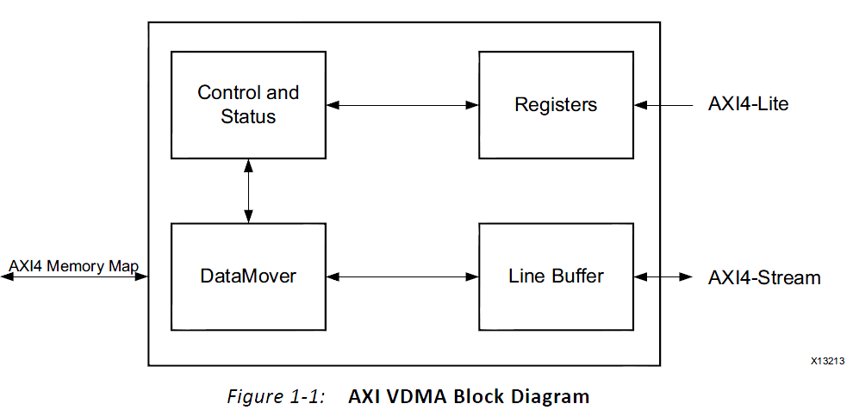
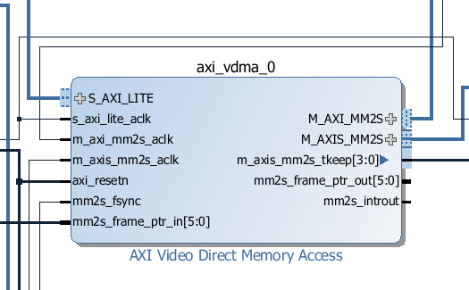
AXI Video Direct Memory Access v6.2 axi_vdma
Allow for efficient high-bandwidth access between the AXI4-Stream video interface and the AXI4 interface
AXI Video Direct Memory Access v6.2 pg020

Slide 19
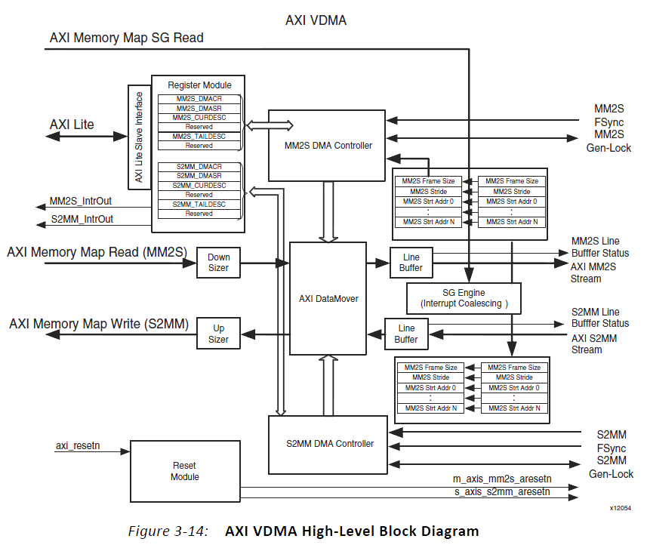
AXI Video Direct Memory Access - AXI4-Stream
Read: AXI Memory Map Read (MM2S) -> AXI MM2S Stream to PL
Write: AXI Memory Map Write (S2MM) <- AXI S2MM Stream from PL
Read
Frame Sync MM2S Fsync
Gen-Lock MM2S Gen-Lock
MM2S IntrOut
Vivado Design Suite, AXI Reference Guide UG1037 (v3.0) June 24, 2015, Xilinx
Notes:
Genlock (generator locking) is a common technique where the video output of one source, or a specific reference signal from a signal generator, is used tosynchronize other television picture sources together.

Slide 20
AXI Video Direct Memory Access v6.2 axi_vdma
After registers are programmed through the AXI4-Lite interface, Control/ Status logic block generates appropriate commands to the Datamover to initiate Write and Read commands on the AXI4 Master interface.
A configurable asynchronous line buffer is used to temporarily hold the pixel data prior to writing it out to the AXI4-Memory Map interface or the AXI4-Stream interface.
In the Write path, the AXI VDMA accepts frames on the AXI4-Stream Slave interface and writes it to system memory using the AXI4 Master interface.
In the Read path, the AXI VDMA uses the AXI4 Master interface for reading frames from system memory and outputs it on the AXI4-Stream Master interface.
Both write and read paths operate independently. The AXI VDMA also provides an option to synchronize the incoming/outgoing frames with an external synchronization signal.

Slide 21
AXI VDMA Summary
Three Frame Sync Options
AXI4-Stream based frame synchronization using the user(0) port
Drives the start-of-frame on the m_axis_mm2s_tuser(0) output for read path
Synchronizes the incoming frame with the start-of-frame on the s_axis_s2mm_tuser(0) input for write path
Streaming to Memory Mapped frame sync port (s2mm_fsync)
Memory Mapped to Streaming frame sync port (mm2s_fsync)
High performance direct memory access between system memory and AXI4-Stream type target peripherals.
Scatter Gather (SG) capabilities also, which allows the CPU to offload transfer control and execution to hardware automation.
The AXI VDMA and the SG engines are built around the AXI DataMover helper core which is the fundamental bridging element between AXI4-Stream and AXI4 memory-mapped buses.
Vivado Design Suite, AXI Reference Guide UG1037 (v3.0) June 24, 2015, Xilinx

Slide 22
AXI VDMA Capabilities
Circular frame buffer access for up to 32 frame buffers and provides the tools to transfer portions of video frames or full video frames.
The ability to park on a frame, allowing the same video frame data to be transferred repeatedly.
Independent frame synchronization and an independent AXI clock, allowing each channel to operate on a different frame rate and different pixel rate.
To maintain synchronization between two independently functioning AXI VDMA channels, there is an optional Gen-Lock synchronization feature. Gen-Lock provides a method of synchronizing AXI VDMA slaves automatically to one or more AXI VDMA masters so the slave does not operate in the same video frame buffer space as the master.
Vivado Design Suite, AXI Reference Guide UG1037 (v3.0) June 24, 2015, Xilinx

Slide 23
AXI Video Direct Memory Access v6.2 axi_vdma
The Xilinx® LogiCORE™ IP AXI VDMA core is a soft IP core
AXI4 Compliant
Primary AXI4 data width support of 32, 64, 128, 256, 512, and 1,024 bits
Primary AXI4-Stream data width support of multiples of 8 up to 1,024 bits
Optional Data Re-Alignment Engine
Optional Genlock Synchronization
Independent, asynchronous channel operation
Dynamic clock frequency change of AXI4-Stream interface clocks
Optional frame advance or repeat on error
Supports up to 32 frame buffers
Supports up to 64-bit address space

Slide 24
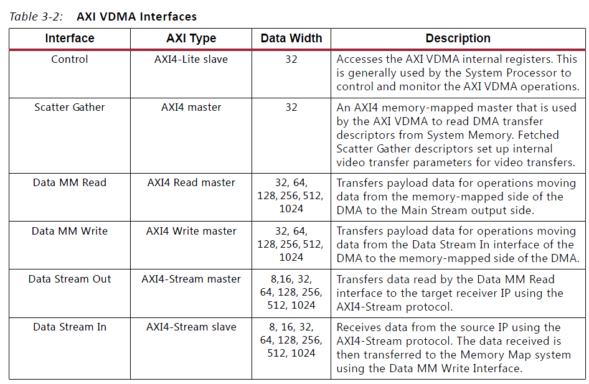
VDMA AXI4 Interfaces
Vivado Design Suite, AXI Reference Guide UG1037 (v3.0) June 24, 2015, Xilinx

Slide 25
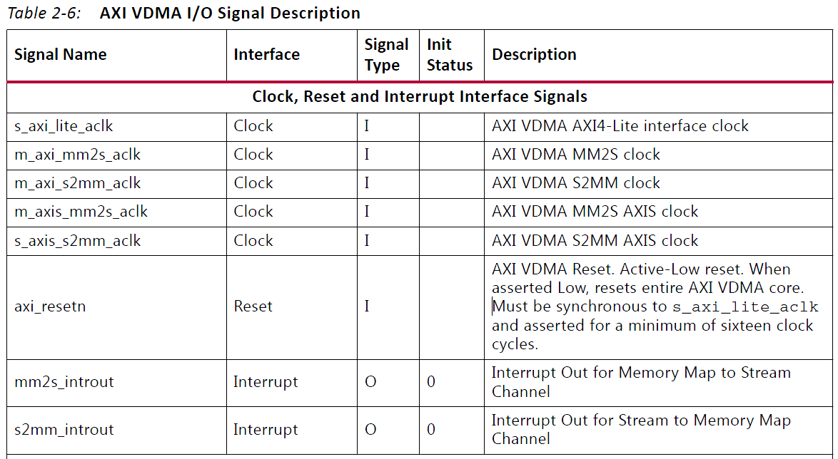
AXI Video Direct Memory Access v6.2: Port Definitions
m_axis_mm2s_aclk is used for VGA display data transmission
s_axi_lite_aclk is used to talk to zynq

Slide 26
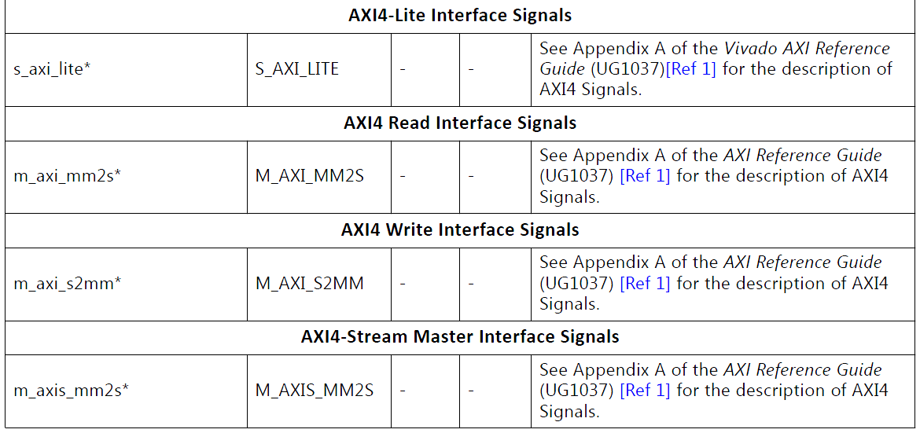
AXI Video Direct Memory Access v6.2: Port Definitions
s_axi_lite is used to talk to Zynq
m_axis_mm2s is used to send data to VGA display, streaming

Slide 27
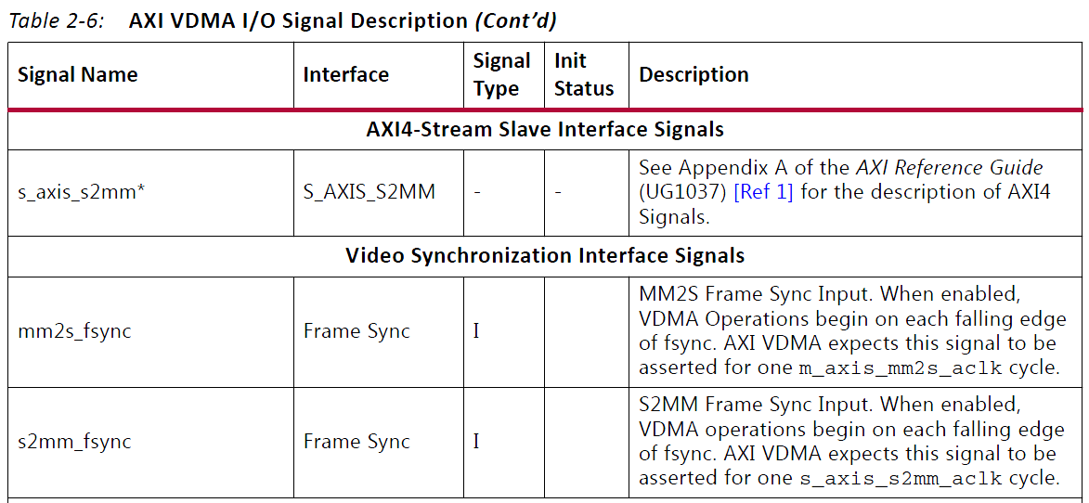
AXI Video Direct Memory Access v6.2: Port Definitions
mms2s_fsync is connected to VGA display controller

Slide 28
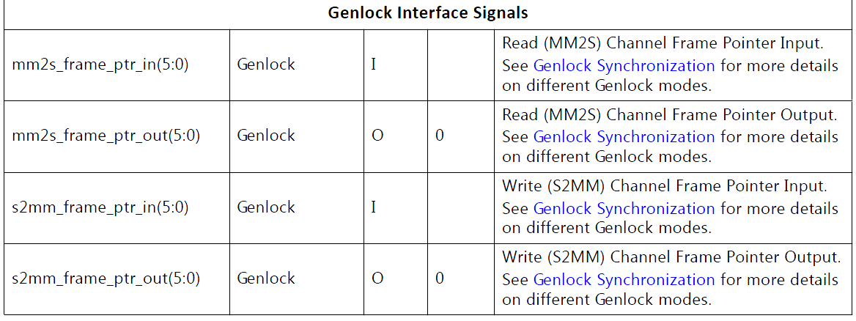
AXI Video Direct Memory Access v6.2: Port Definitions
mm2s_frame_ptr_in[5:0]=0b000000, slave genlock mode, current fram number is 0b000000.
2⁶=64 frames

Slide 29
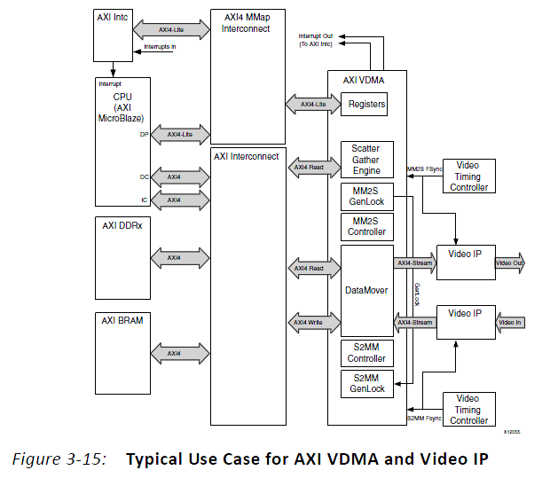
AXI Video Direct Memory Access
Up to 64 frames – from Memory to VDMA to Display
Video Output
Video Input
Memory
Vivado Design Suite, AXI Reference Guide UG1037 (v3.0) June 24, 2015, Xilinx

Slide 30
AXI Video Direct Memory Access v6.2: Basic Options
Address Width (32-64) - between 32 and 64
Frame Buffers
For an address space greater than 32 bits a maximum of 8 frame buffers are allowed.
Enable Write Channel - enables S2MM Channel.
Memory Map Data Width
The desired AXI4 data width for the S2MM channel. Valid values are 32, 64, 128, 256, 512 and 1,024.
Write Burst Size
The maximum size of the burst cycles on the AXI S2MM memory map Write interface. For example, if the burst length is set to 16, the maximum burst on the memory map interface is 16 data beats.
Stream Data Width
The AXI4-Stream data width for the S2MM channel. Valid values are multiples of 8 up to 1,024 bits. This value must be less than or equal to the Memory Map Data Width.

Slide 31
AXI Video Direct Memory Access v6.2: Basic Options
Line Buffer Depth
The line buffer depth for the S2MM channel (line buffer is stream data wide).
Enable Read Channel - enables the MM2S channel.
Memory Map Data Width
The desired AXI4 data width for the MM2S channel. Valid values are 32, 64, 128, 256, 512 and 1,024.
Read Burst Size
The maximum size of the burst cycles on the AXI MM2S memory map Read interface. For example, if the burst length is set to 16, the maximum burst on the memory map interface is 16 data beats.
Stream Data Width
The AXI4-Stream data width for the MM2S channel. Valid values are multiples of 8 up to 1,024 bits. This value must be less than or equal to the Memory Map Data Width.
Line Buffer Depth
The line buffer depth for the MM2S channel (line buffer isstream data wide).

Slide 32
AXI Video Direct Memory Access v6.2: Advanced Options
Enable Asynchronous Mode
This setting allows m_axi_mm2s_aclk, m_axi_s2mm_aclk, s_axi_lite_aclk, m_axis_mm2s_aclk, and s_axis_s2mm_aclk to be asynchronous from each other.
When Asynchronous Clocks are disabled, all clocks must be at the same frequency and from the same source.
Read Channel Options - provides advanced options for the MM2S2 path.
Fsync Options - various frame synchronization modes of AXI VDMA.
mm2s fsync - AXI VDMA starts processing each frame on the falling edge of the mm2s_fsync input.

Slide 33
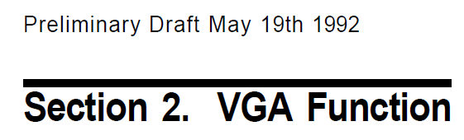
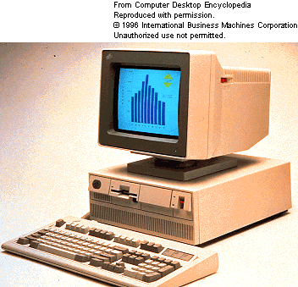

History of VGA Since 1987
Video Graphics Array (VGA) refers specifically to the display hardware first introduced with the IBM PS/2 line of computers in 1987
640 x 480 pixels with 8-bit color requested frame buffer of 300 KB
640x480x8=2457600 bits = 307200 bytes 300KB

Slide 34

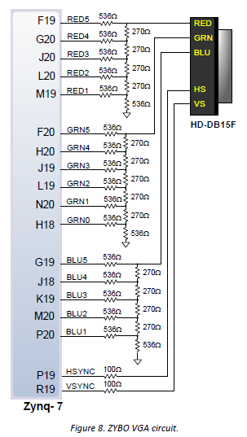
VGA on Zybo Board
5-bit RED
6-bit GREEN
5-bit BLUE
0 to 0.7volt analog outputs

Slide 35
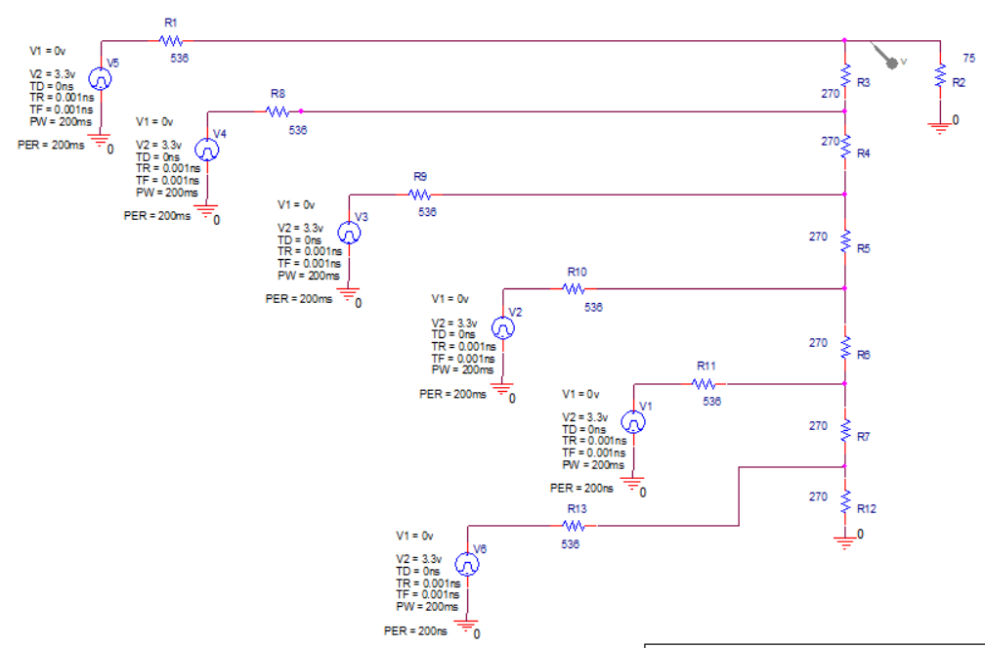
VGA Circuit on Zybo Board
5-bit RED
6-bit GREEN
5-bit BLUE
Pin input impedance is 75Ω.
Analog voltage range is from 0V to 0.7V.

Slide 36
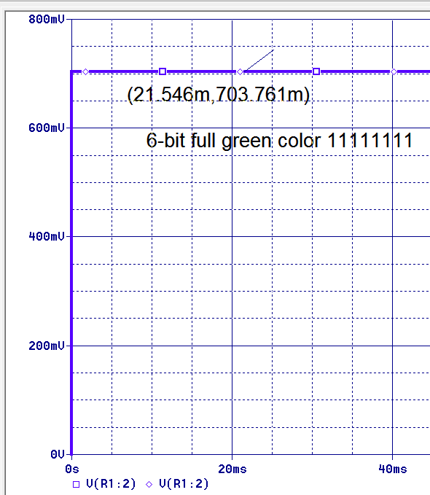
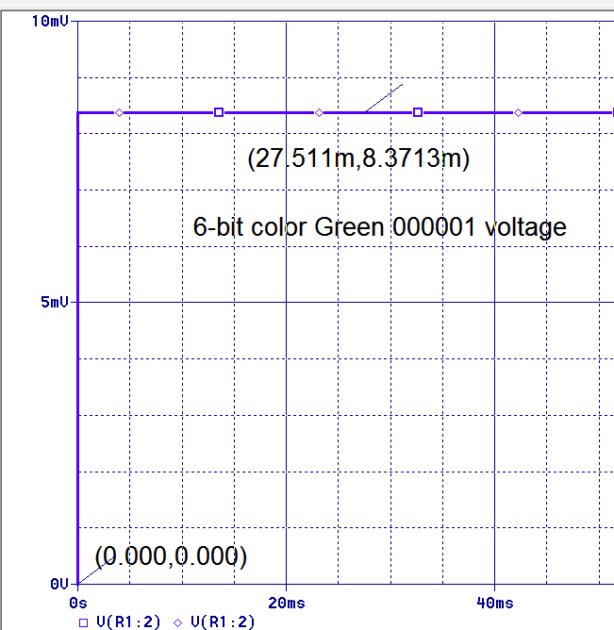
6-Bit Color SPICE Simulation Voltage
Maximum voltage
6-bits | (V) | Not linear
111111 | 0.70376
111110 | 0.69539 | 0.3428x2=0.6856
011111 | 0.34281
000011 | 0.02933 | 0.00837x3=0.02511
000001 | 0.00837
Minimum voltage

Slide 37
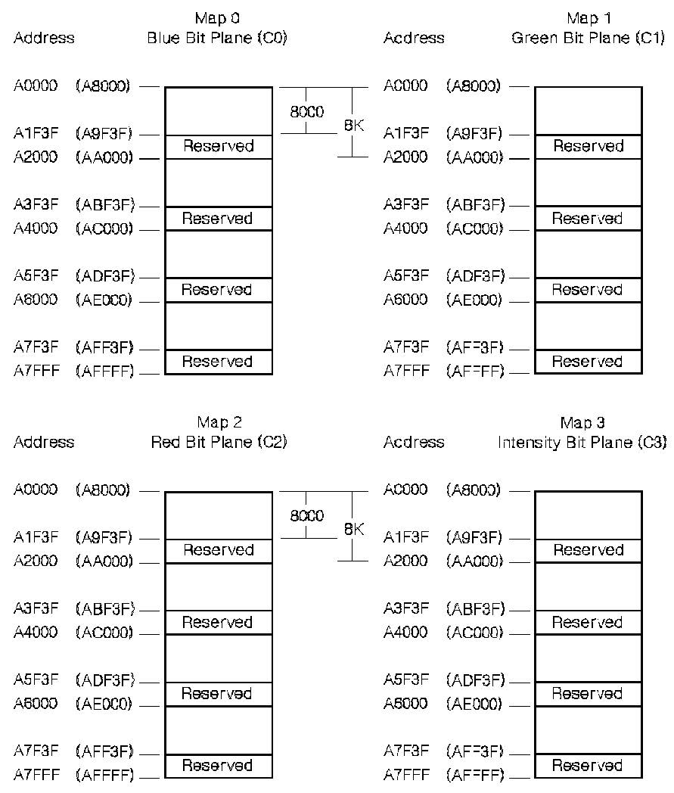
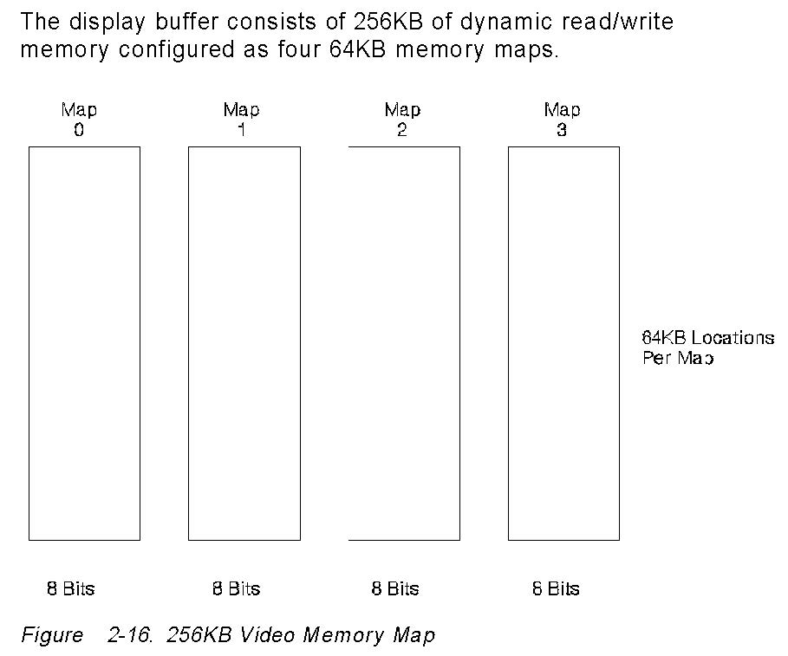


One Possible Memory Map
The display buffer consists of 256 KB of dynamic read/write memory configured as four 64KB memory maps.
Each map stores one color and Map 3 stores intensity
Portable Network Graphics (PNG) Specification
Red, Green, Blue, Intensity
R G B I
Lecture 18 AXI DMA and VGA Spring 2019 HUST -- 37
IBM

Slide 38
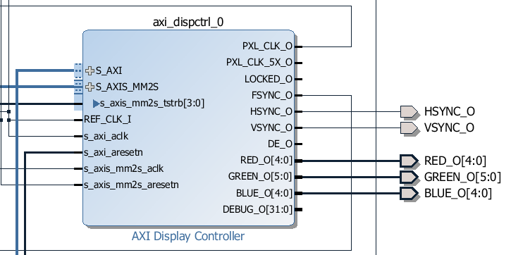
VGA Display Controller axi_dispctrl_v1-00_a from Digilent
S_AXI is connected to Zynq – axi-lite
S_AXIS_MM2S is connected to axi_vdma for data transfer
S_axis_mm2s_tstrb[3:0] is connected to m_axis_mm2s_tkkeep[3:0] axi_vdma
REF_CLK_I and s_axi_aclk are connected to FCLK_CLK0 of Zynq
PXL_CLK drives m_axis_mm2s_aclk
FSYNC is connected to mm2s_fsync of xi_vdma
From
VDMA
To VGA
Lecture 18 AXI DMA and VGA Spring 2019 HUST -- 38
Axi vga display controller axi_dispctrl_0

Slide 39
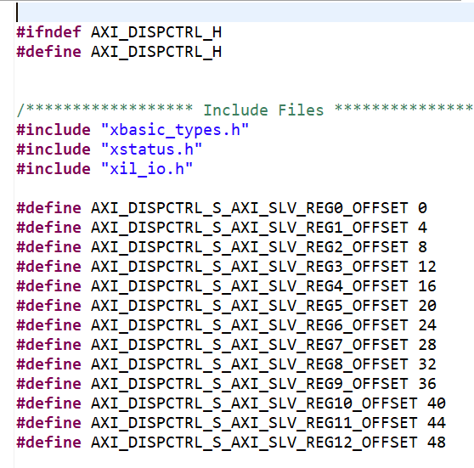
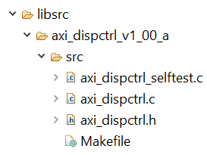
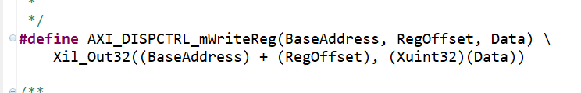

Driver for VGA Display Controller axi_dispctrl_v1-00_a
Lecture 18 AXI DMA and VGA Spring 2019 HUST -- 39
Axi vga display controller axi_dispctrl_0

